Slide 1
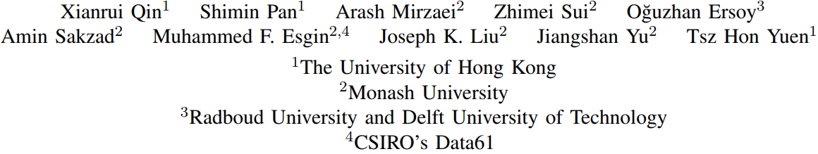
BlindHub: Bitcoin-Compatible Privacy-Preserving Payment Channel Hubs Supporting Variable Amounts
S&P 2023
Notes:
具有可扩展性和互操作性的匿名原子锁

Slide 2
Outline
Background
Preliminaries
A2L - S&P’2021
Generalized Channel - ASIACRYPT’2021
Proposal
Performance Analysis

Slide 3
1. Background

Slide 4
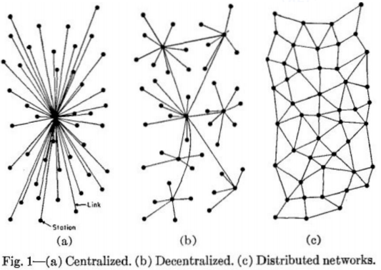
PCN vs PCH
PCN Limitation:
PCN payment requires sequential channel updates from sender to receiver, breaking unlinkability when there is a single intermediary
PCNs raise the issue of finding paths in a network and maintaining the network topology
Tumbler
/Mixer
PC Hubs (PCH)
PC Networks (PCN)

Slide 5
Abstract
PCH Definition:
Payment channel hubs (PCHs) constitute a promising solution to the inherent scalability problem of blockchain technologies, allowing for off-chain payments between sender and receiver through an intermediary, called the tumbler.
Problem：
All existing Bitcoin-compatible PCH constructions that guarantee relationship anonymity allow only a (predefined) fixed payment amount.
This work：
The first Bitcoin-compatible PCH：provide security and privacy
Blind Adaptor Signature, an adaptor signature protocol built on top of a blind signature scheme.
BlindChannel, one of the channel parties is unable to see the channel balances.
BlindHub, a three-party (sender, tumbler, receiver) atomic and privacy preserving protocol.

Slide 6
Challenges in blockchain: a path towards PCH
Unlinkability: None (including the mixer) can determine which sender paid to which receiver.
Atomicity: Mixers is not necessarily honest. Either a payment is successful or the money goes back to the sender.
Scalability: Transaction throughput problem. PCHs supports off-chain payments that each party opens a channel with a tumbler.
All the existing Bitcoin compatible PCH constructions that guarantee relationship anonymity would require the transaction amount to be fixed. Fixing the amount requires either multiple PCH systems or running one PCH system multiple times

Slide 7
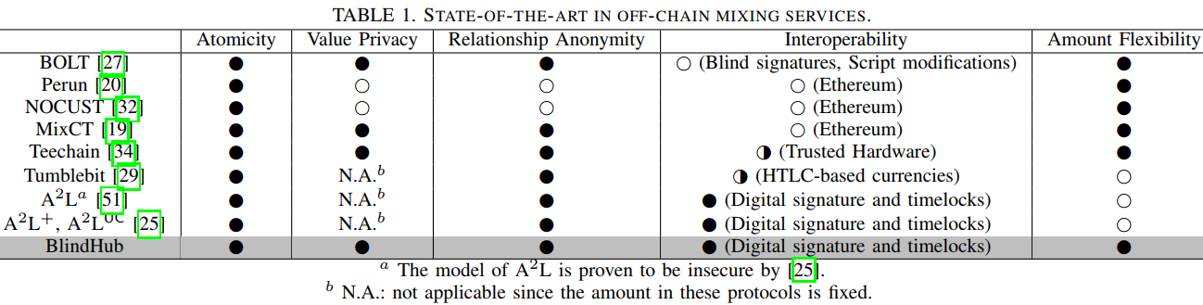
Related Work and Problem Statement
Is it possible to construct a Bitcoin-compatible PCH system with value privacy and relationship anonymity that also supports variable payment amounts?

Slide 8
Security and Privacy Goals
Griefing Resistance : The PCH should only initiate a payment procedure if R can prove that the payment request are previously backed by some coins locked by a S during the payment procedure
Atomicity: The PCH should not be exploited to print new money or steal existing money from honest users, even when parties collude.
Value Privacy: T should not know the payment amount between S and R
Relationship Anonymity: T should not be able to find out if there is any relation between S and R of a specific payment.

Slide 9



Griefing Attack
Receiver
Sender
$
Mixer
$
$
$
$
$$$$
Lock
$

Slide 10
2. Preliminaries

Slide 11
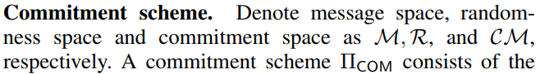
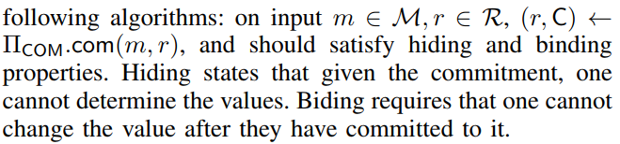
Commitment scheme
Notes:
隐藏性(Hiding)和绑定性（Binding）。隐藏性为承诺值不会泄露任何关于消息m的信息；绑定性是指任何恶意的承诺方都不能将承诺打开为非m的消息且验证通过
Pedersen commitment具有完美隐藏性、计算绑定性

Slide 12
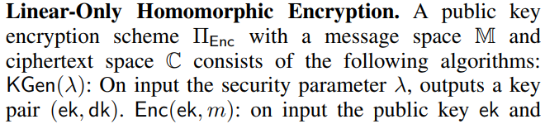
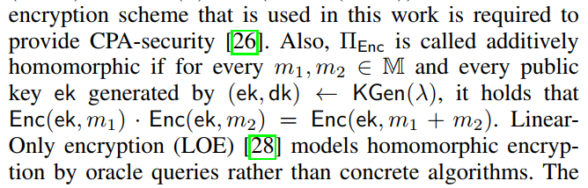
Homomorphic encryption scheme

Slide 13
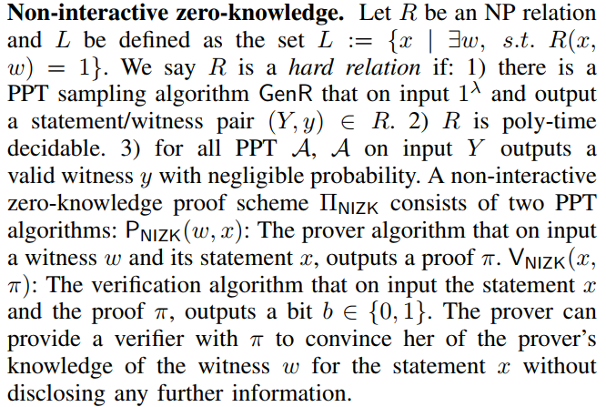
NIZK
Notes:
Prover 想向 Verifier 证明知道w，但是不想把w告诉Verifier
可靠性，完备性，零知识性

Slide 14
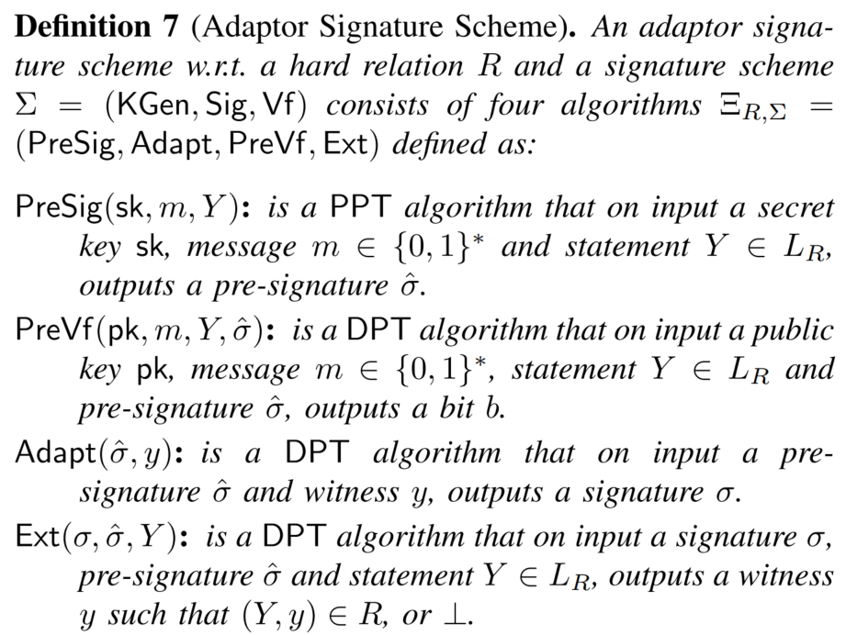
Adaptor signature scheme

Slide 15
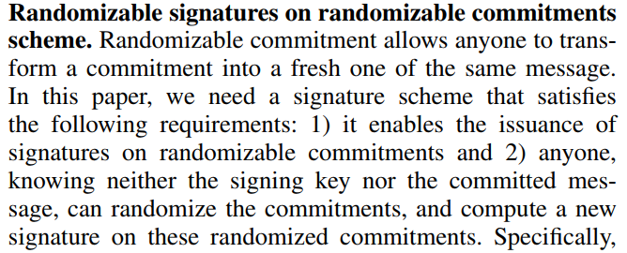
Randomizable signatures on randomizable commitment

Slide 16
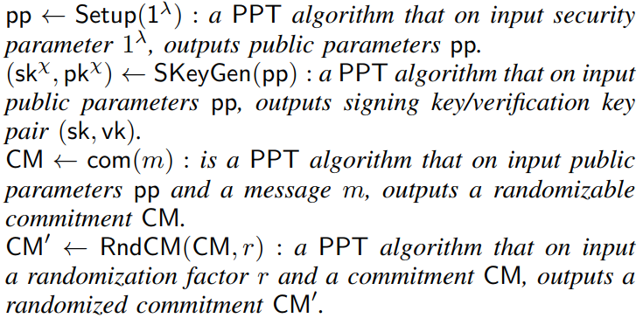
Randomizable signatures on randomizable commitment

Slide 17
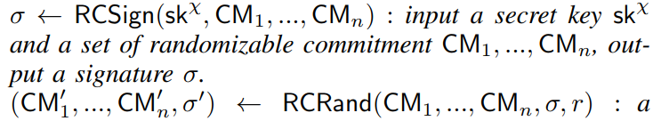
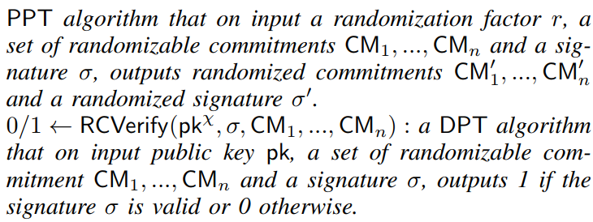
Randomizable signatures on randomizable commitment
Bind two or more commitments
Rerandomize

Slide 18
A2L: Anonymous Atomic Locks for Scalability and Interoperability in Payment-Channel Hubs
S&P 2021
Erkan Tairi TU Wien
Pedro Moreno-Sanchez IMDEA Software Institute
Matteo Maffei TU Wien
Notes:
具有可扩展性和互操作性的匿名原子锁

Slide 19
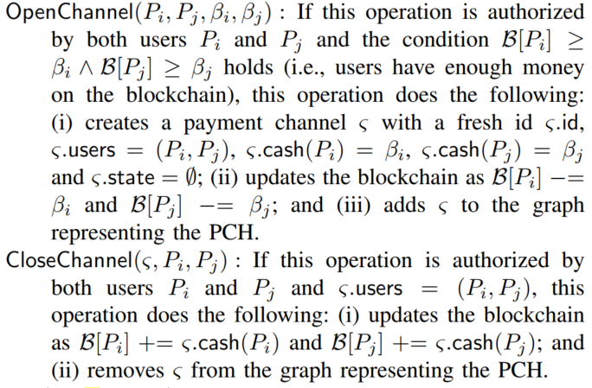
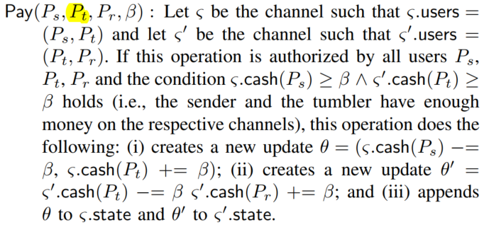
PCH Functionality

Slide 20
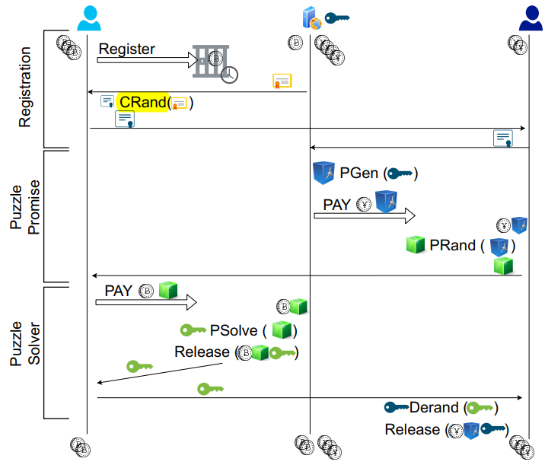
Overview
Withstand griefing Attack
Tool:
Adaptor signature
Randomizable Puzzle
Randomizable Signature
Method:
Synchronization puzzle protocol

Slide 21
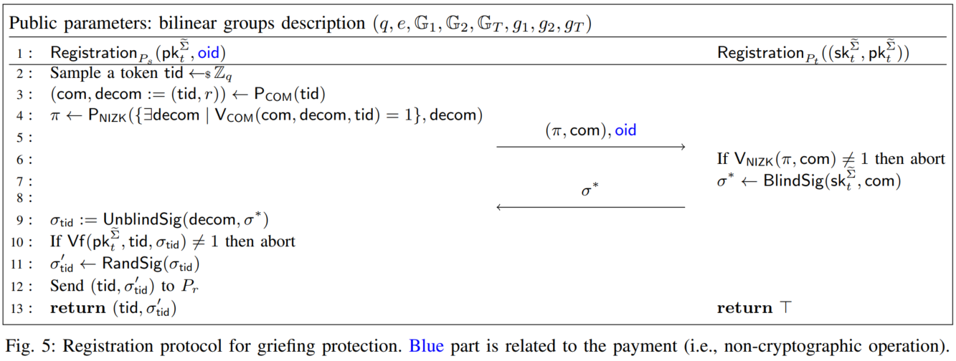
Registration
S
T
Generate token
Sign token
Send signed token to R

Slide 22
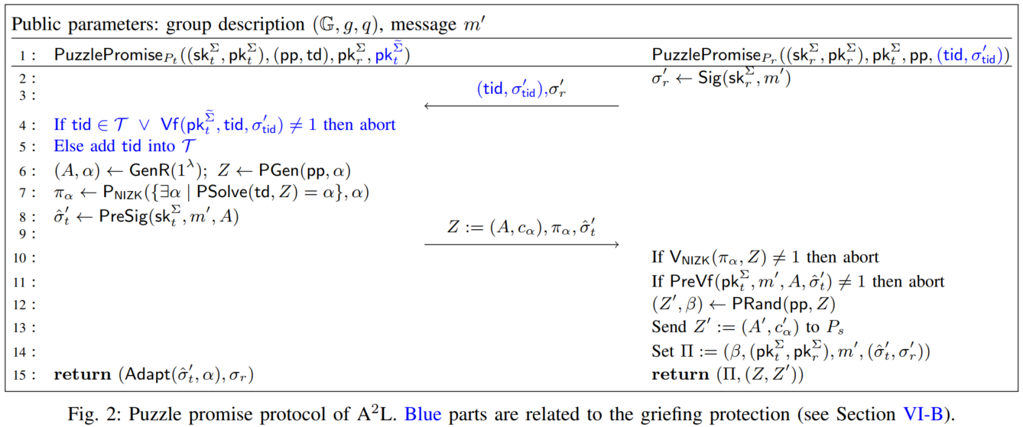

Puzzle promise
T
R
Verify token
Generate a hard relation and hind the solution in puzzle Z
Generate pre-signature of $TX_{TR}$
Verify
Rerandomize puzzle Z

Slide 23
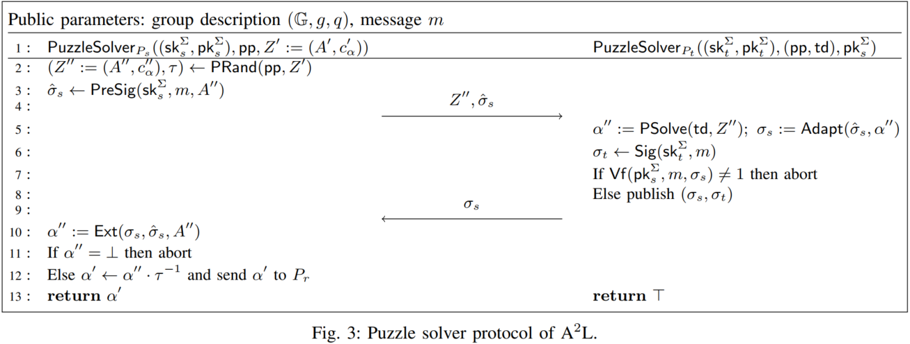



Puzzle solver
S
T
Rerandomize puzzle Z’
Generate pre-signature of $TX_{ST}$
Open puzzle Z’’
Adapt signature of $TX_{ST}$
Publish $TX_{ST}$ on chain
Extract the solution
Remove randomness

Slide 24
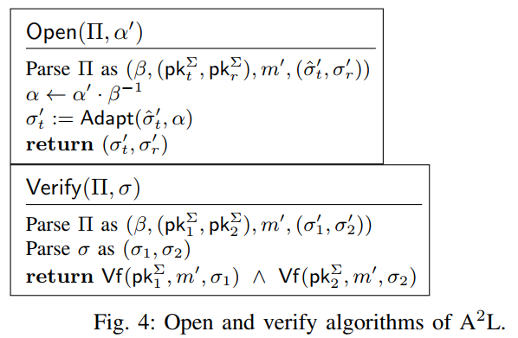


Open and Verify
R
Remove randomness
Adapt signature of $TX_{TR}$
Publish $TX_{TR}$ on chain

Slide 25
Future works
Any amount --- S&P’23
New attacks --- CCS’22
Multiple mixers
Reused setup
Reduce the number of round

Slide 26
3. Overview

Slide 27
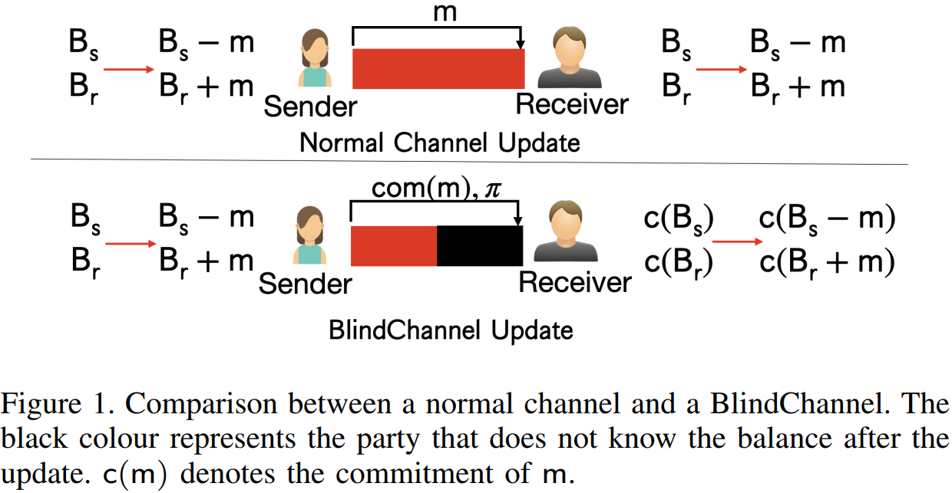
BlindChannel
Amount consistency proof
Unblind party
Blind party

Slide 28
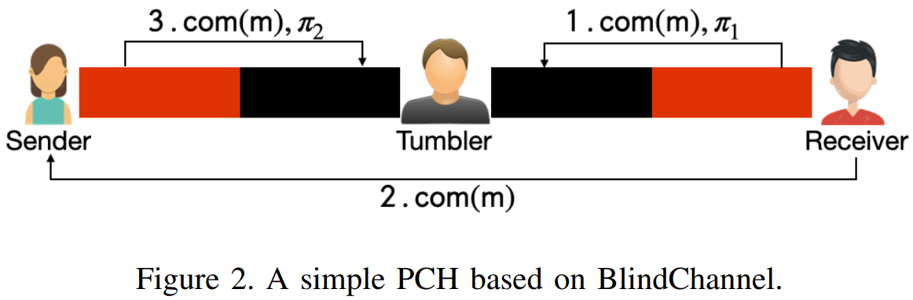
Value Privacy
Amount consistency proof
Amount consistency proof
Q: A malicious S can just refuse to pay T after R is paid by T, hence a loss of T’s money
Atomicity

Slide 29
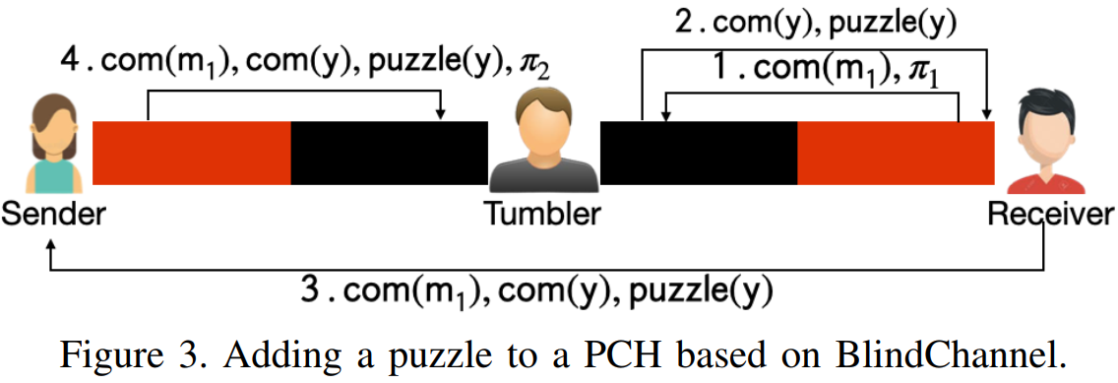
Atomicity
Linking Puzzle with Transaction Amount
conditional state
Q: Not enough to guarantee the atomicity when the amount is hidden

Slide 30
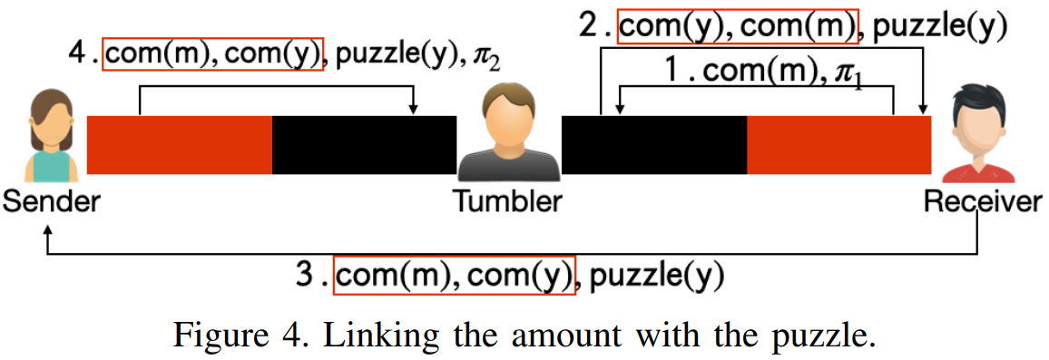
Atomicity
Linking Puzzle with Transaction Amount
Q: T can easily know the relationship between S and R by observing which pair of sender and receiver share the same commitment of the amount, the puzzle, and the link

Slide 31
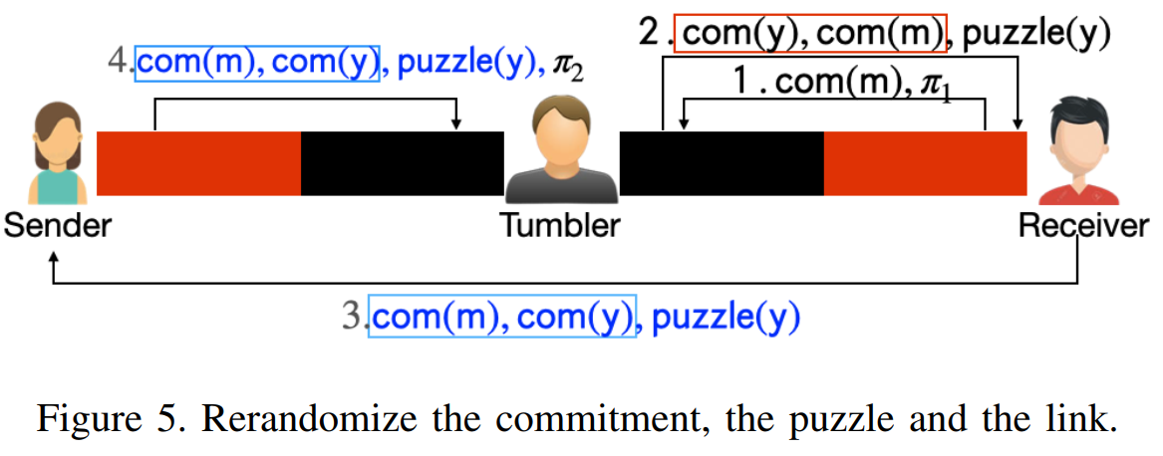
Relationship Anonymity
Randomizable Commitment, Puzzle and Linkage

Slide 32
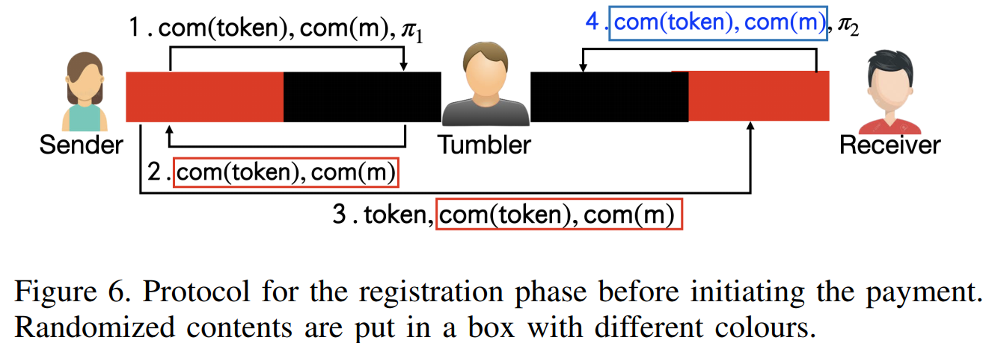
Griefing Resistance
Linking Token with transaction amount

Slide 33
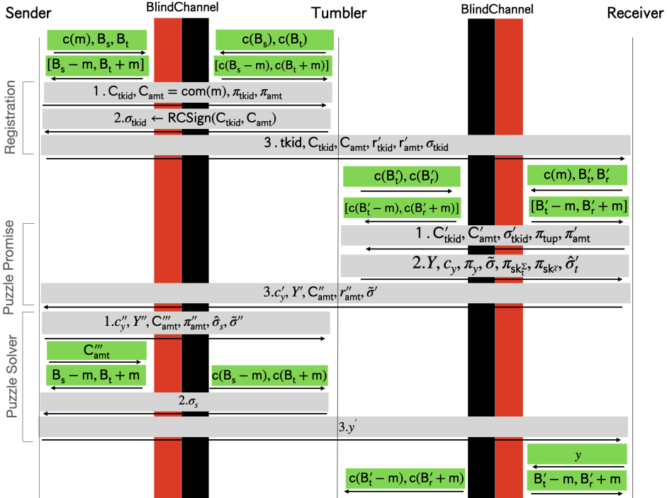
BlindPCH

Slide 34
4. Blind Adaptor Signature

Slide 35
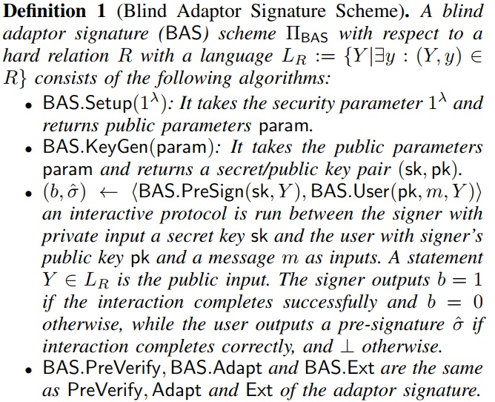
Blind Adaptor Signature

Slide 36
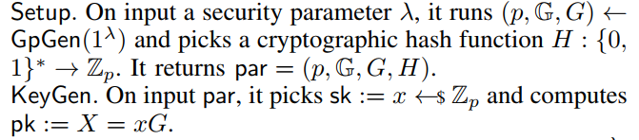
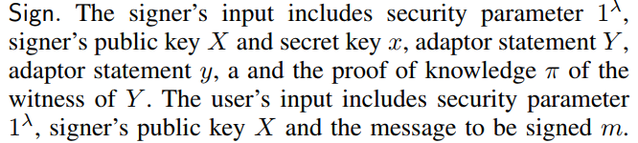
Blind Adaptor ECDSA Construction

Slide 37
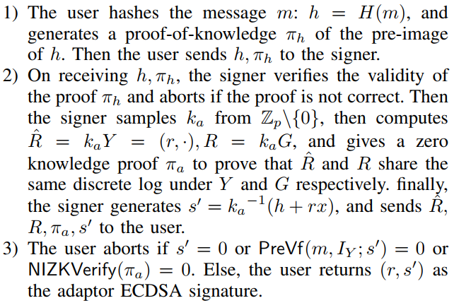
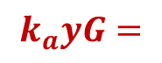
Blind Adaptor ECDSA Construction
$$k_{a}yG=$$

Slide 38
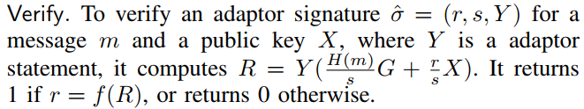

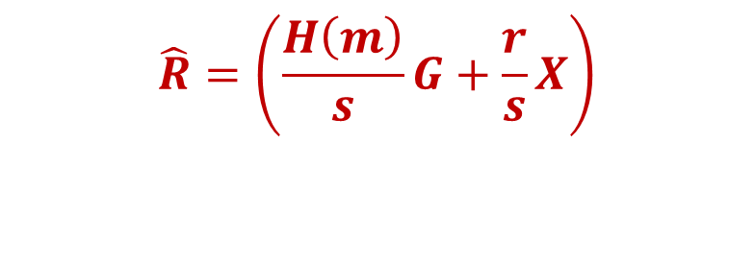
Blind Adaptor ECDSA Construction
$$\hat{R}=\left(\frac{H\left(m\right)}{s}G+\frac{r}{s}X\right)$$
$$Correctness:$$
$$Check ZKVerify\left(R,\hat{R},Y\right)=1 and r=f(R)$$

Slide 39
4. BlindChannel

Slide 40
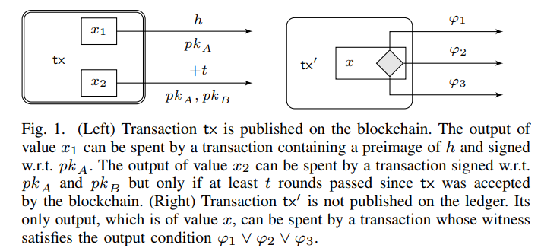
Outputs and transactions

Slide 41
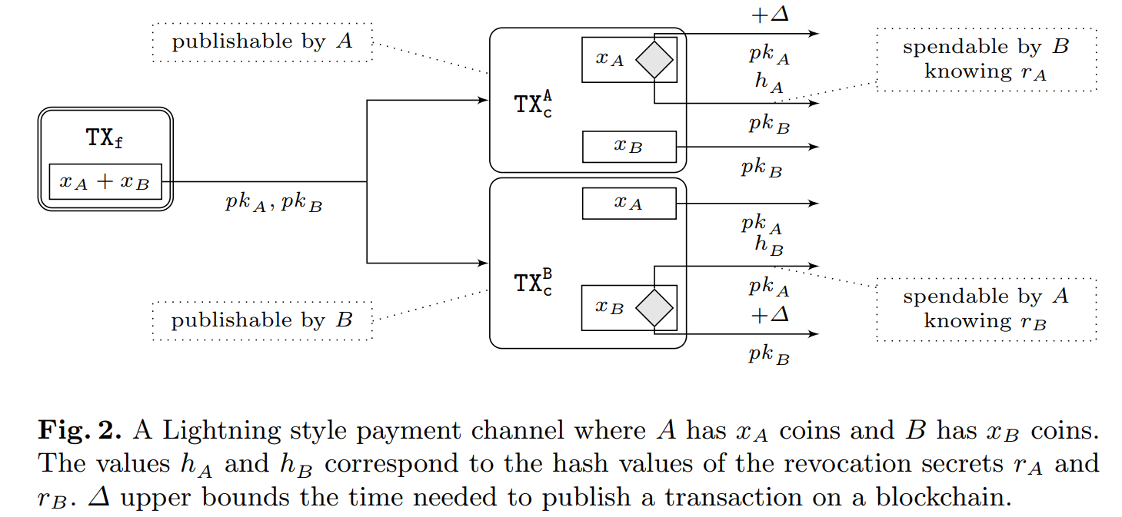
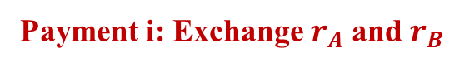
Lightning style payment channel
Payment i: Exchange${ r}_{A}$ and $r_{B}$
$h_{A}=H(r_{A})$ $h_{B}=H(r_{B})$

Slide 42
Lightning style payment channel
Close the channel

Slide 43
Lightning style payment channel
Punish (if someone publishes old transaction)

Slide 44
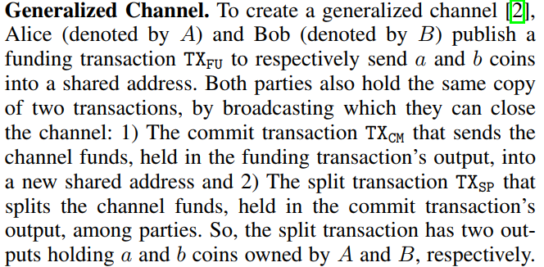
Generalized Channel

Slide 45
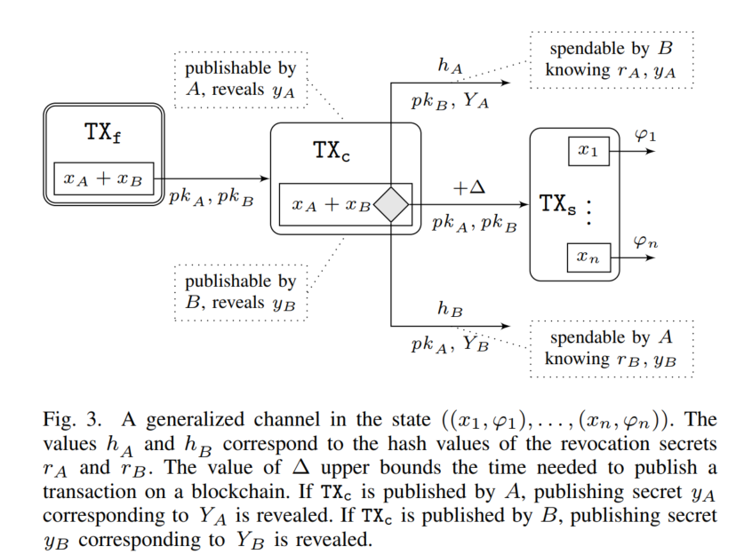
Generalized Channel - ASIACRYPT 2021

Slide 46
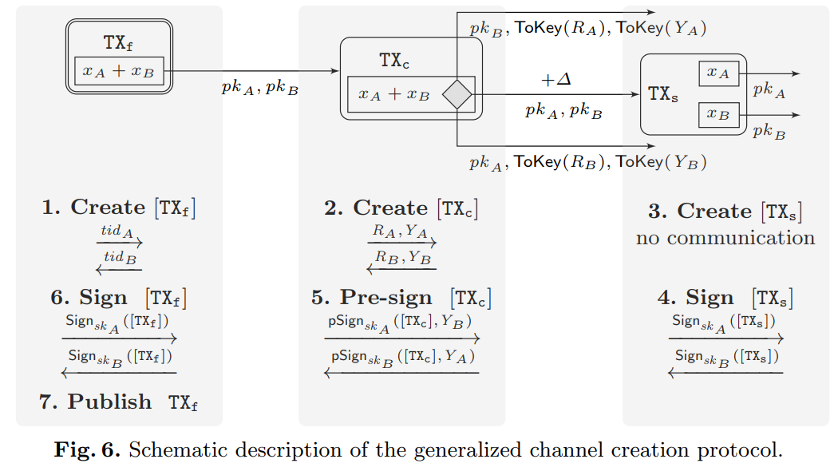
Generalized Channel - ASIACRYPT 2021

Slide 47
BlindChannel
BlindChannel allows two parties to pay to each other arbitrarily many times without publishing every single transaction on the blockchain.
Only one of the parties, i.e. the unblind party, determines the payment amount and the other party, i.e. the blind party, cannot see the payment amount.
As required by BlindHub protocol, all payments are conditioned on solving a puzzle

Slide 48
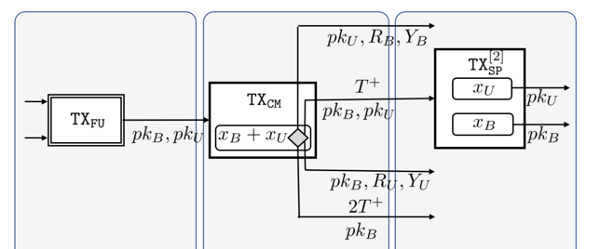
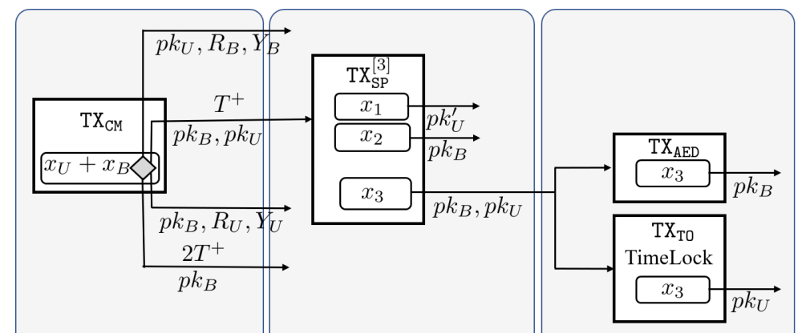
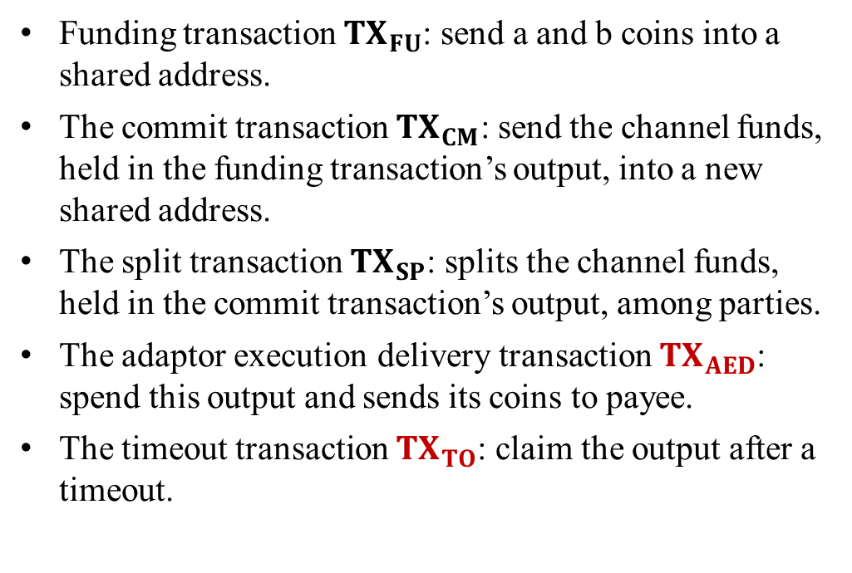
BlindChannel – Transaction type
Funding transaction $TX_{FU}$: send a and b coins into a shared address.
The commit transaction $TX_{CM}\text{:}$ send the channel funds, held in the funding transaction’s output, into a new shared address.
The split transaction $TX_{SP}$: splits the channel funds, held in the commit transaction’s output, among parties.
The adaptor execution delivery transaction $TX_{AED}$: spend this output and sends its coins to payee.
The timeout transaction $TX_{TO}$: claim the output after a timeout.

Slide 49
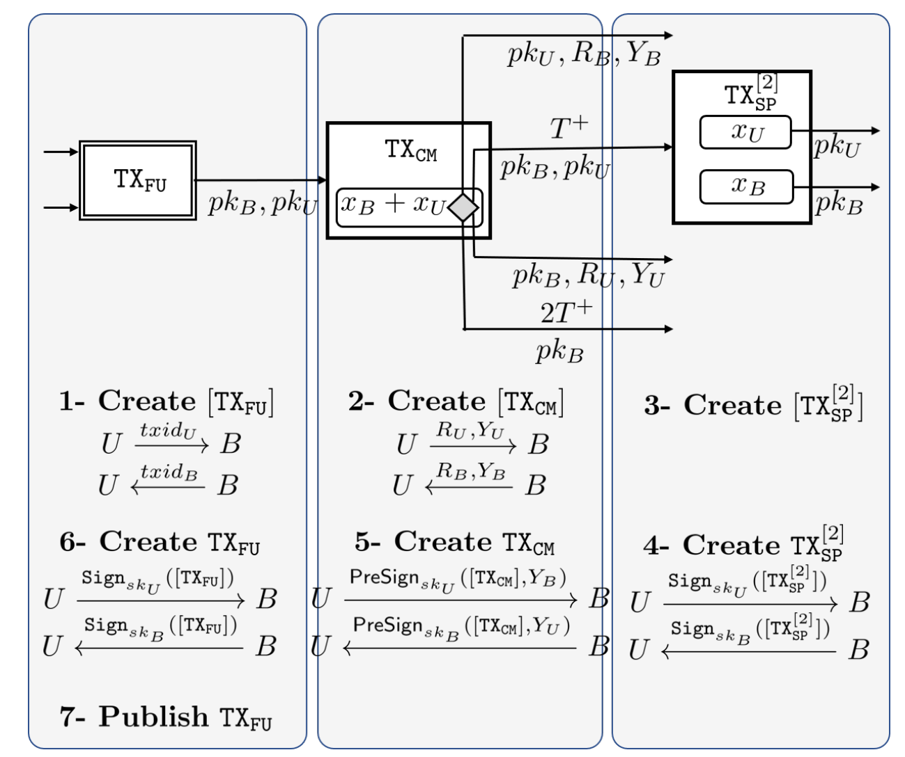
BlindChannel – Create

Slide 50
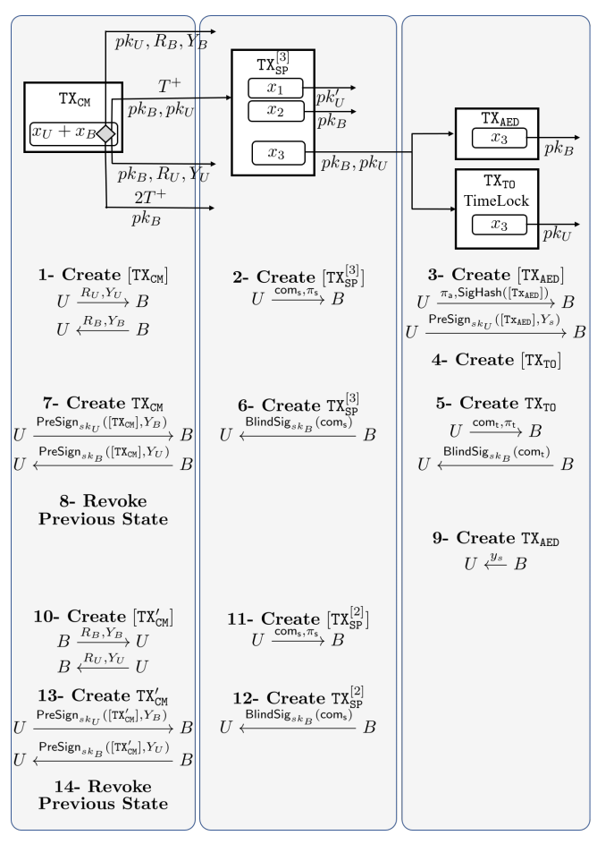
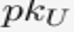
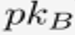
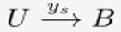
Update
Adaptor signature
U pays to B

Slide 51
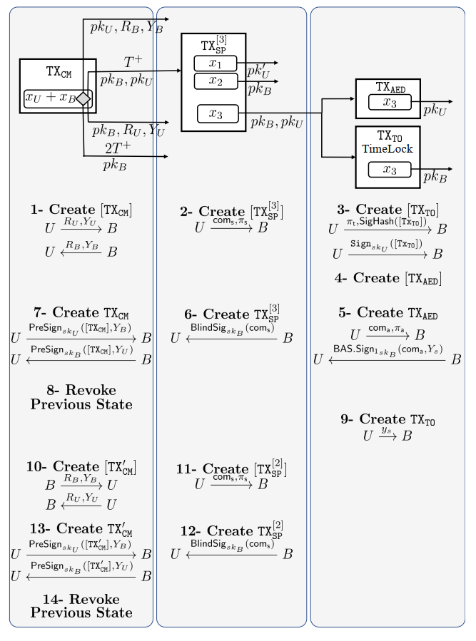

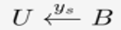
Update
B pays to U
Blind adaptor
signature

Slide 52


BlindChannel – Close

Slide 53
5. BlindHub

Slide 54

Registration
Hidden token
Hidden amount
Sign token
Rerandomize

Slide 55


Puzzle promise
Amount consistency proof
Verify token and amount
Add into registry
Generate a hard relation and encrypt the solution y
Bind amount and puzzle
Generate blind pre-signature of $TX_{TR}$
Rerandomize

Slide 56



Puzzle solver
Rerandomize
Generate pre-signature of $TX_{ST}$
Decrypt the solution
Adapt the signature of $TX_{ST}$
Extract
Remove randomness

Slide 57



Open
Remove randomness
Adapt signature of $TX_{TR}$
Publish $TX_{TR}$ on chain

Slide 58
6. Performance Analysis

Slide 59

Performance
ECDSA-based adaptor signature
ECDSA-based blind adaptor signature
The elliptic curve secp256k1
Garbled circuit-based zero-knowledge proof
The A2L protocol is in the same order of computational cost of our protocol

Slide 60
THANK YOU!

